Slide 1
Strategic Coordination of Social Care R&D
Cydlynu Strategol Ymchwil a Datblygu Gofal Cymdeithasol
Dr Dan Venables
Ymchwil Iechyd a Gofal Cymru(LLC) / Health and Care Research Wales(WG)

Slide 2
Sefydliadau sy’n cydweithio
Collaborating Organisations
Ymchwil Iechyd a Gofal Cymru (LLC)
Ysgol Ymchwil Gofal Cymdeithasol Cymru
Gofal Cymdeithasol Cymru
Banc data Cysylltu Gwybodaeth Dienw(SAIL)
Gwasanaeth Gwybodaeth a Dadansoddi (GGD), Llywodraeth Cymru
Health and Care Research Wales (WG)
Wales School for Social Care Research
Social Care Wales
Secure Anonymised Information Linkage Databank (SAIL)
Knowledge and Analytical Services (KAS), Welsh Government

Slide 3
Grŵp Cydlynu Strategol Ymchwil a Datblygu Gofal Cymdeithasol
Social Care R&D Strategic Coordination Group
Grŵp strategol ar y cyd Ymchwil Iechyd a Gofal Cymru(LLC) a Gofal Cymdeithasol Cymru
Cadeirydd allanol – Yr Athro Fiona Verity
Dod ag ystod eang o randdeiliaid ynghyd:
Y Trydydd Sector
Gofal Cymdeithasol
Prifysgolion
Darparwyr Preifat/Annibynol
Y Cyhoedd
ADSS
Llywodraeth Cymru
Gofal Cymdeithasol Cymru
Arolygiaeth Gofal Cymru
Trafod datblygiadau mewn Ymchwil a Datblygu gofal cymdeithasol a chynghori ar y cyfeiriad strategol
Joint strategic group for Health and Care Research Wales(WG) and Social Care Wales
External Chair – Professor Fiona Verity
Brings together broad range of stakeholders including:
Third sector
Social work
Universities
Private providers
Public
ADSS-C
Welsh Government
Social Care Wales
Care Inspectorate Wales
Discuss developments in social care R&D and advise on strategic direction

Slide 4
Strategaeth Y&D Gofal Cymdeithasol Cymru:2018-23
Social Care R&D Strategy for Wales 2018-23
Pum maes Ffocws
Cynnwys y Cyhoedd
Blaenoriaethau Ymchwil
Defnydd o ddata sydd eisioes yn bodoli, a data sydd yn cael ei gasglu fel mater o drefn
Datblygu’r gweithlu a sefydliadau
Cyfathrebu defnyddio ymchwil
Five Focus Areas
Involving the public
Research Priorities
Use of existing and routinely collected data
Developing the workforce and organisations
Communicating and using research

Slide 5
Today’s session
Sesiwn heddiw
Dr Lisa Trigg
Cyfarwyddwr Cynorthwyol,Ymchwil, Data a Gwybodaeth
Assistant Director, Research, Data and Intelligence
Gofal Cymdeithasol Cymru / Social Care Wales

Slide 6
Nod y sesiwn hon
Aim for this session
Gweithio gyda’n gilydd i gynhyrchu cwestiynau ymchwil:
Sydd yn flaenoriaeth uchel i’ch sefydliadau
‘Atebadwy’
Yr ydych yn eu cefnogi (o ran amser y medrech ei ddynodi a/neu ddata y gallech ei ddarparu)
To work together to generate research questions which are:
A high priority for your organisations
‘Answerable’
Have your support (time and/or data)

Slide 7
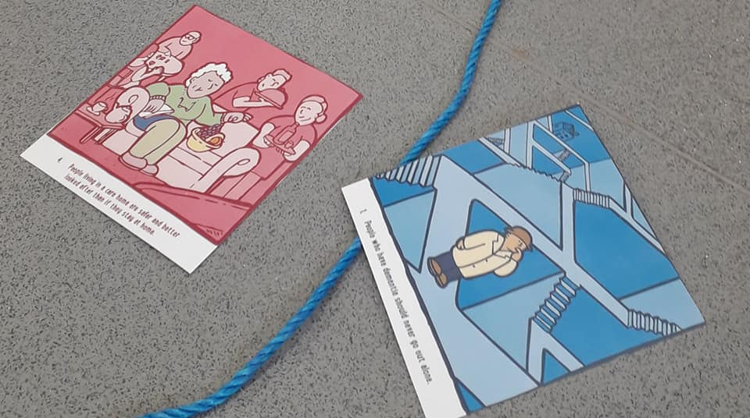
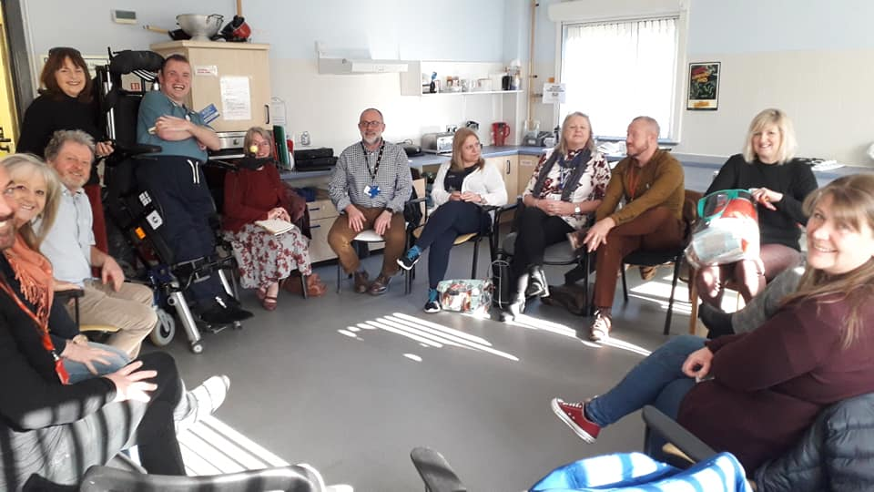
Gwahanol fathau o ymchwil
Different types of research

Slide 8
Gwahanol fathau o ymchwil
Different types of research
Gwaith/ Work
Cymuned/Community
Addysg/
Education
Gofal cymdeithasol/ Social care
Ysbyty/ Hospital
Cartrefu/ Housing

Slide 9
Sut mae heddiw’n wahanol?
What’s different about today?
Buddsoddiad gan Llywodraeth Cymru a’r Cyngor Ymchwil Economaidd a Chymdeithasol
Ymchwilwyr yn barod i gymryd eich syniadau ymlaen
Ystod eang o randdeiliaid o wahanol wasanaethau ac ALL
Cyfle i ennill eich ymrwmiad a’ch cefnogaeth
Investment by Welsh Government and the Economic & Social Research Council
Researchers ready to take your ideas forward
A broad range of stakeholders from across LAs and services
An opportunity to gain your commitment and support for this research

Slide 10
Arolwg o ‘r gweithdy
Overview of the workshop exercise
Gweithio ar fyrddau gyda chydlynydd i adnabod syniadau ymchwil o flaenoriaeth uchel
Dewis 2-3 flaenoriaeth i’w rhannu gyda’r grŵp ehangach
Amser coffi
Pleidleisio ar y blaenoriaethau
Cytuno ar y ffordd ymlaen
Work on tables with facilitator to identify high priority research ideas
Choose 2-3 priorities to share with the wider group
Break for coffee
Vote on the overall priorities
Agree way forward

Slide 11
Prif syniadau o bob bwrdd
Top ideas from each table
Syniad
Syniad
Ayyb
Idea
Idea
etc

Slide 12
Camau Nesaf
What’s next
Bydd LLC a Bancdata Sail yn asesu cwestiynau ymchwil cysylltu data
Bydd Ysgol Ymchwil Gofal Caymdeithasol Cymru yn asesu’r cwestiynau ymchwil eraill
Bydd Gofal Cymdeithasol Cymru yn eich diweddaru ar y cynnydd a’r penderfyniadau sy’n cael eu gwneud
Cyfarwyddwyr a Phenaethiaid Gwasanaethau i gefnogi ymchwil a chasglu data
WG and Sail Databank to assess data linkage research questions
Wales School for Social Care Research to assess other research questions
Social Care Wales to update you on progress of research and decisions
Directors and Heads of Services to support research and data collection

